Slide 1
Creative Search Strategies
Creativity Research Project
Nevo Himmelhoch

Slide 2
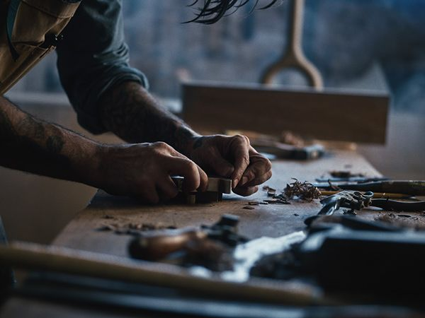
Philosophy of Craft and Style
Abstract medium into Physical medium
Craft as an ambassador for personal style
Craft should be measured by infinite variables

Slide 3
Yuval Hart’s research as reference
Clusters theory
Correlation between exploitation and exploration
“BFS” Vs. “DFS” people

Slide 4
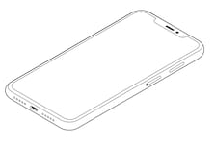

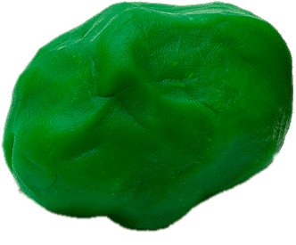
The Experiment

Slide 5
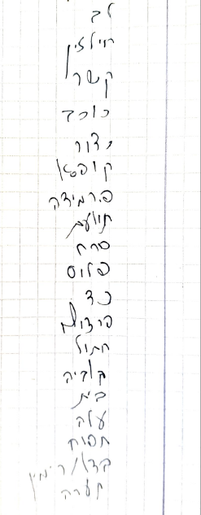
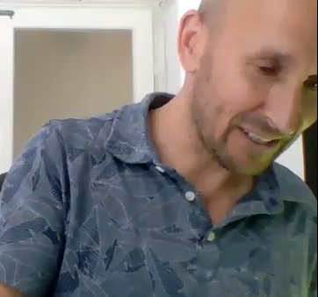
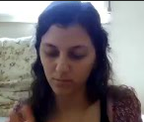

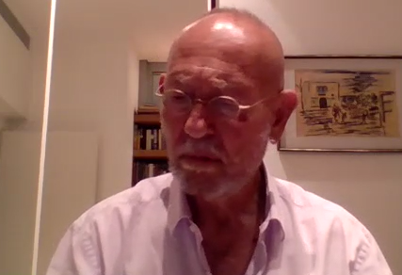
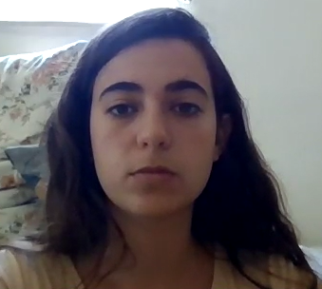

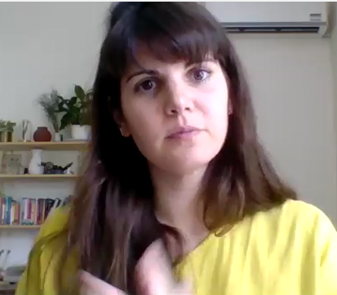

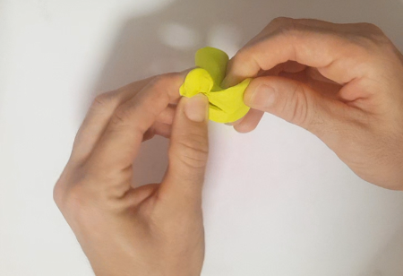
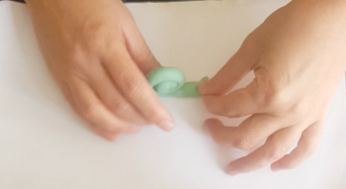
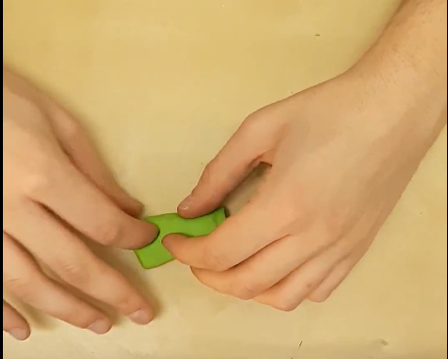
Data collection and analysis
OpenCV
Numpy
PyPlot

Slide 6
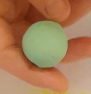
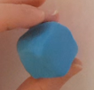
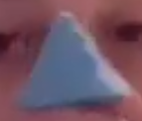
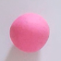
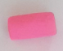
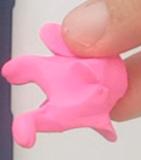
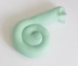
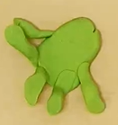
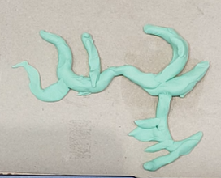
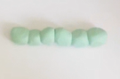
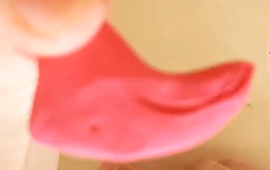
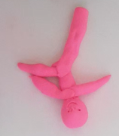
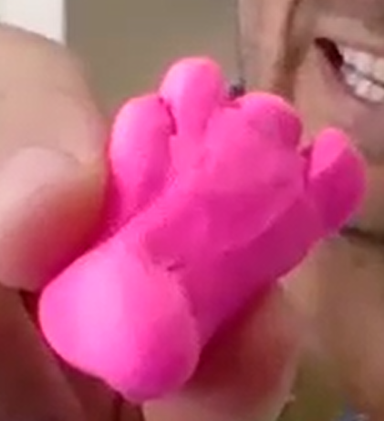
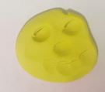
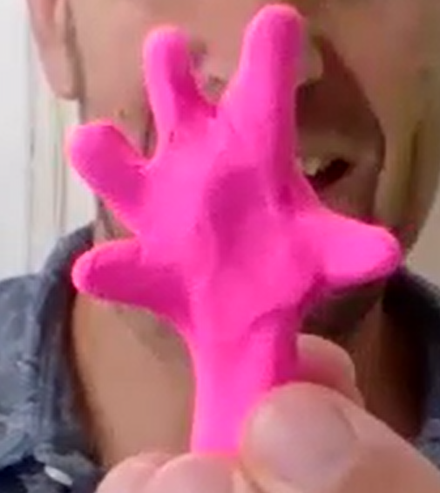
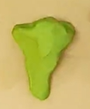
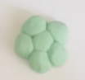
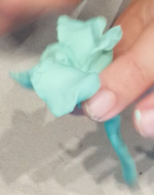
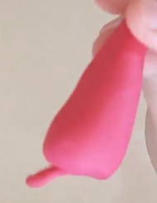
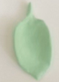
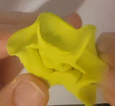
Participants exploit different meaning categories
Geometric Shapes
Animals
Body and Body Parts
Vegetation

Slide 7

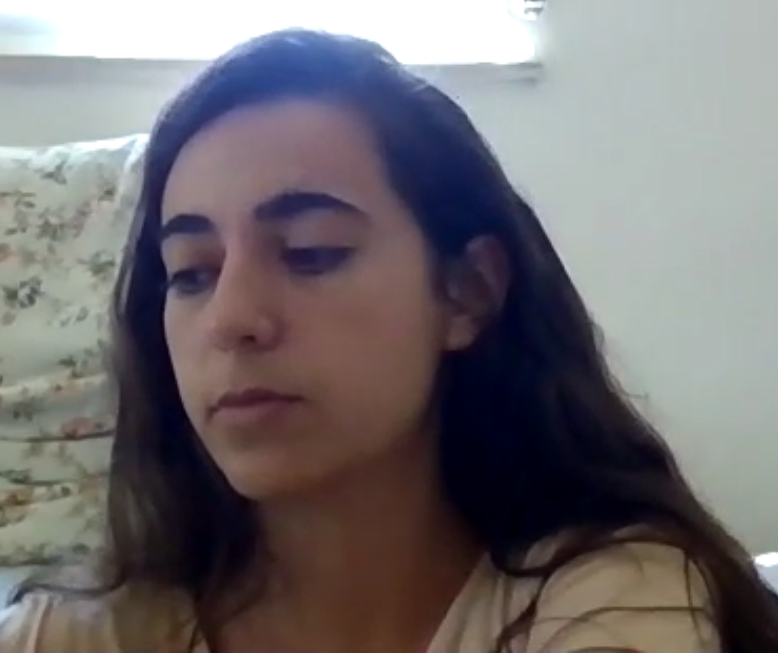

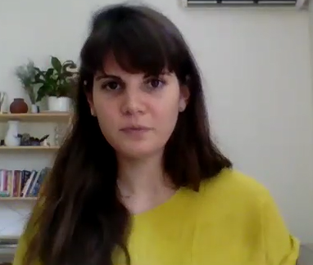
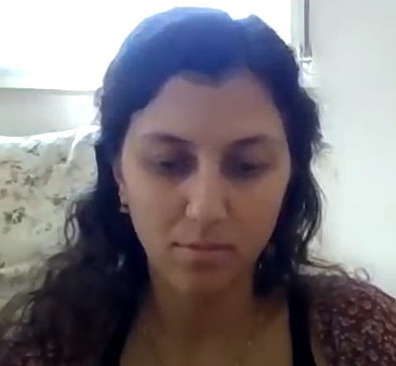
Exploitation Score
At least
20% happier in relation to other facial expressions
Exploration Score

Slide 8
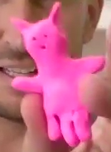


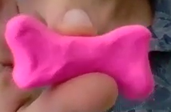
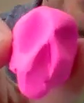

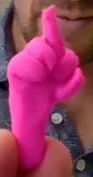
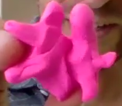
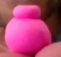
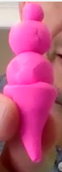
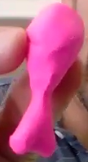
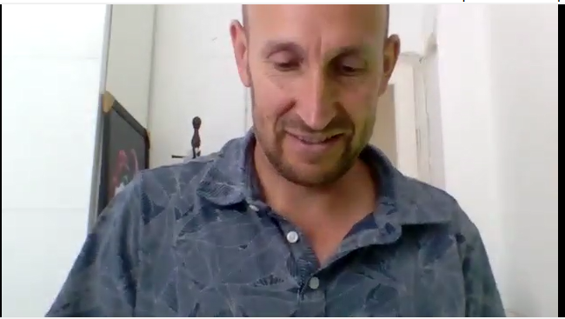
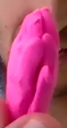
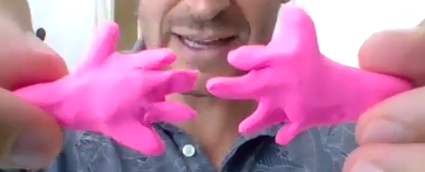
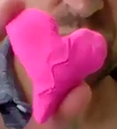
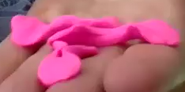
Example
Outer Space
Military
Body parts
Emotions
Food

Slide 9
Exploitation Score
Exploration Score

Slide 10
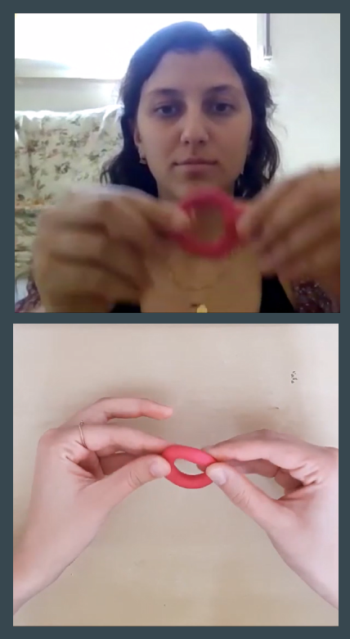









Another example
Beetle
Chili pepper
Ice Cream
Cat Mask
Toros
Pregnancy Test
Shovel
Sunflower Seed
Drop
Waves with Surfboard

Slide 11

Different kinds of transitions between associations

Slide 12






Intersection
Stars
Fruit
Shape
Can be measured by camera recording
Turning a Star into an Apple

Slide 13




Intersection
Body parts
Animals
Wordplay
Can be measured by examining participants’ notes
Turning a Nose into a Turtle

Slide 14



Adding
Ancient Coin
Vase
A bundle of coins
+
=
Can be measured by examining participants’ notes

Slide 15


Scenario Imagining

Slide 16



Scenario Imagining
Can be measured by examining participants’ notes and survey

Slide 17

Participant’s current environment
Can be measured by camera recording

Slide 18

Participant’s personal experience/memory
UNMEASURABLE?

Slide 19
Re-Examining the information

Slide 21
# Clusters
At least
20% happier in relation to other facial expressions
# Transition Changes

Slide 22
Future Work
Encode and automate everything
Study participants’ feelings throughout the experiment
Learn through hand gestures
Get more familiarized with psychology behind personal experience/memory facial expressions

Slide 23
Comments?

